Slide 1
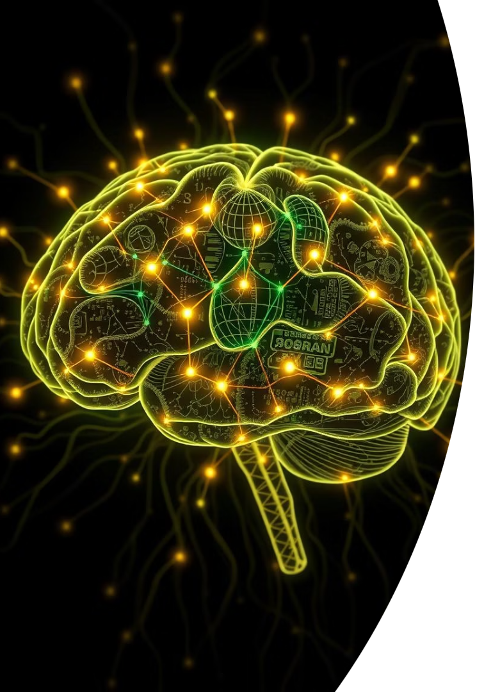

Neural Networks
CSC(372) - Semester VI
St. Xavier's College
by Kiran Bagale

Slide 2




Course Description: Neural Network Fundamentals
Underlying Principles
Explore the foundational concepts that govern neural network behavior.
Core Architectures
Understand different network structures from basic to complex.
Learning Processes
Delve into how neural networks learn and adapt.
This course provides an introduction to neural networks. It covers architecture, learning processes, single-layer and multilayer perceptrons, and recurrent neural networks.

Slide 3
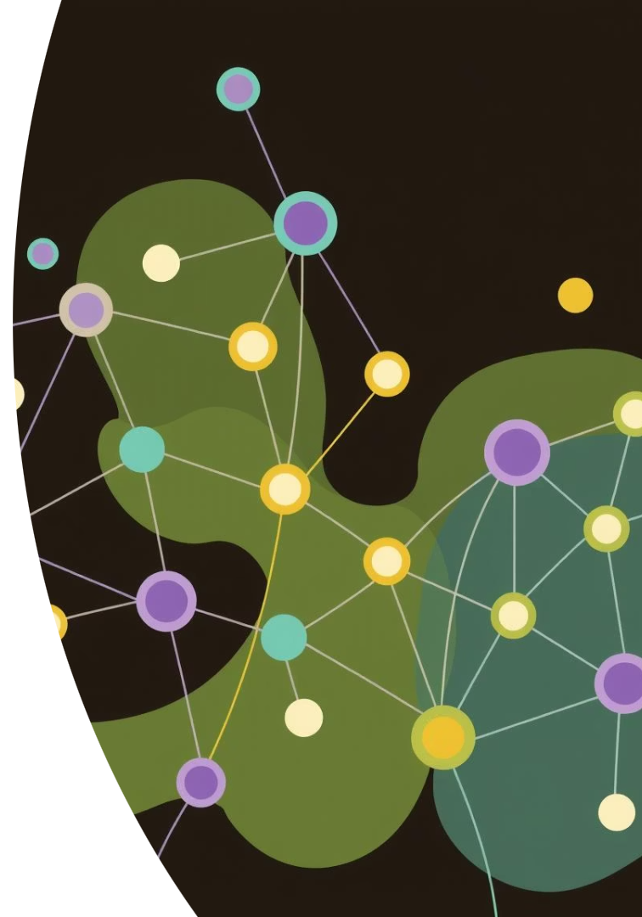
Course Objectives: Deep Dive into Neural Networks
1
Grasp Core Principles
Understand the fundamental concepts and design of neural networks.
2
Explore Architectures
Learn about various network structures, including perceptrons.
3
Analyze Learning
Examine how networks learn and adapt through different processes.
4
Discover Advanced Models
Get introduced to recurrent neural networks and their applications.

Slide 4





Course Content Overview
Foundations of Neural Networks
Basic building blocks and historical context.
Network Architectures
Single-layer and multi-layer perceptrons.
Learning Algorithms
Supervised and unsupervised learning methods.
Recurrent Neural Networks
Understanding sequential data processing.
For a detailed breakdown of topics, please refer to the Course Syllabus.

Slide 5


Pioneers of Artificial Intelligence
Geoffrey Everest Hinton
John McCarthy
British-Canadian computer scientist known as "the Godfather of AI" for his work on artificial neural networks.
In 1955, he coined the term "Artificial Intelligence," defining it as "the science and engineering of making machines that can perform tasks that would normally require human intelligence."
"Read enough to develop your intuitions, then trust your intuitions."

Slide 6

Course Intuition: Why Neural Networks?
An Introduction
Why Consider Them?
Discover the foundational concepts and significance of neural networks in modern AI.
Understand the practical advantages and widespread applications of neural networks across industries.
No Convincing Needed
The utility and power of neural networks speak for themselves through their diverse capabilities.

Slide 7


Neural Networks: Quick Answers and Deeper Insights
The Short Answer
The Long Answer
It's a bit more complicated than that...
They're useful!
OpenAI and Final Fantasy 16 showcase their complexity and powerful applications.
They're fast!
They're easy to implement!
They're cute!
They're definitely not taking over the world!

Slide 8
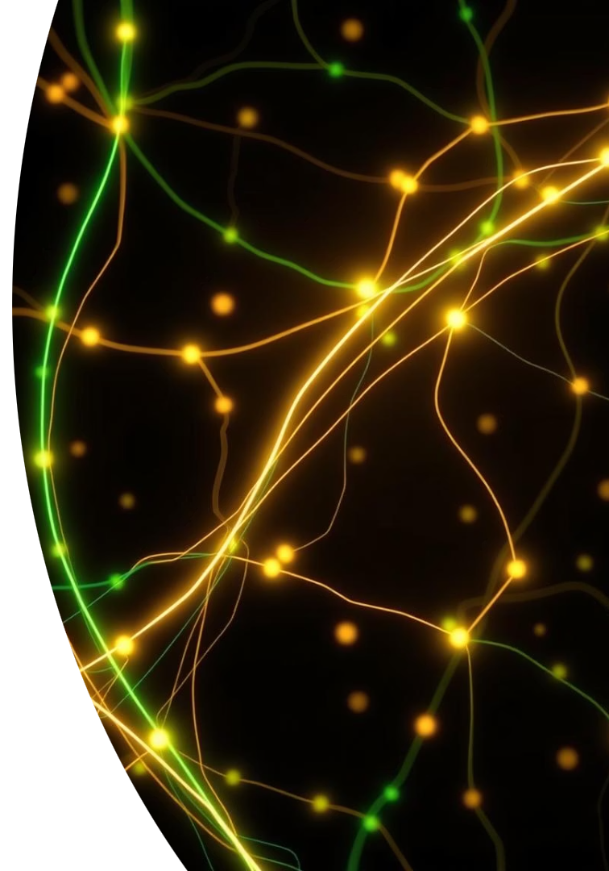
Goals of This Lecture: Unraveling Neural Networks
What & How
Teach what a neural network is and its operational mechanics.
Why & Why Not
Explore the advantages and disadvantages of using them.
Which & Where Next
Identify current networks and future directions.
Along with a simulated environment demo and tips for building networks.

Slide 9




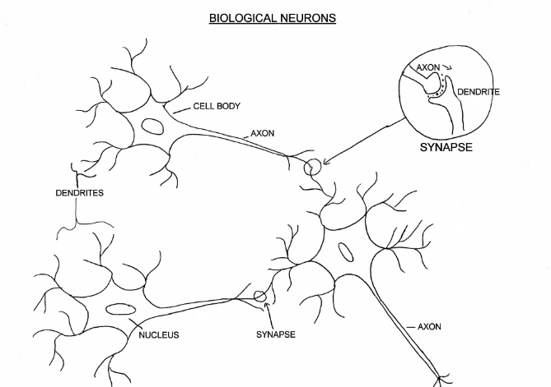
Biological Neurons: The Brain's Building Blocks
Dendrites
Soma (Cell Body)
Receive signals from
other neurons.
Processes incoming signals
and generates output.
Synapse
Axon
Junction where signals are
passed between neurons.
Transmits electrical signals to
other neurons.
Biological neurons are the fundamental units of
the nervous system.
They process and transmit information through
electrical and chemical signals.

Slide 10




Artificial Neuron: The Perceptron
Output
1
A single output, often 0 or 1.
Activation Function
2
Transforms the weighted sum.
Weighted Sum
3
Inputs multiplied by weights, then summed.
Inputs
4
Numerical data fed into the neuron.
An artificial neuron, or perceptron, is a mathematical function inspired by biological neurons. It takes multiple inputs, applies weights, sums them, and passes the result through an activation function to produce an output.

Slide 11
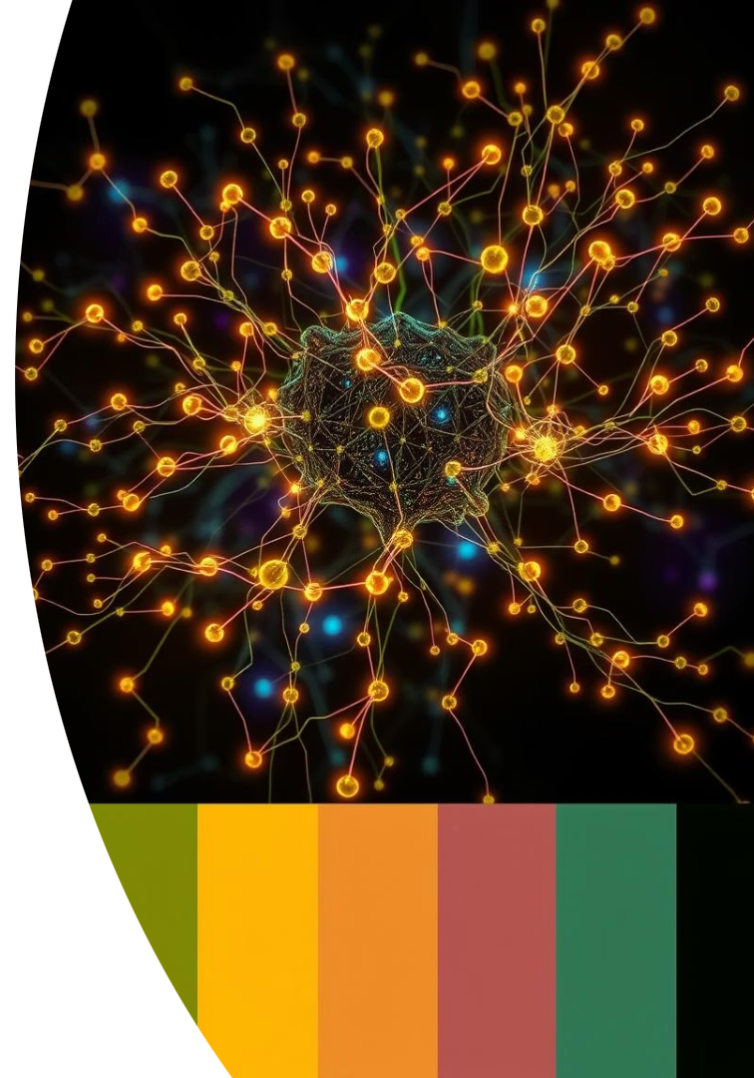
Unveiling Artificial Neurons and Neural Networks
W
Neuron
W
Σ
f(n)
Outputs
INPUTS
Activation Function
W
W
W=Weight

Slide 12
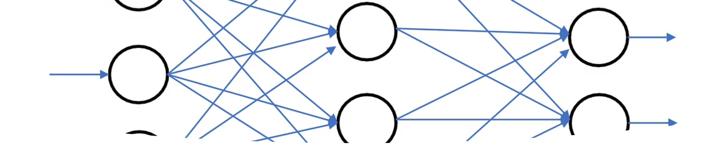
Neural Network Terminologies: The Basics
1
Input Layer
2
Hidden Layers
3
Output Layer
Receives initial data for processing. Each node represents a feature.
Intermediate layers. They perform complex computations. Multiple layers can exist.
Produces the final result. Its structure depends on the task.

Slide 13

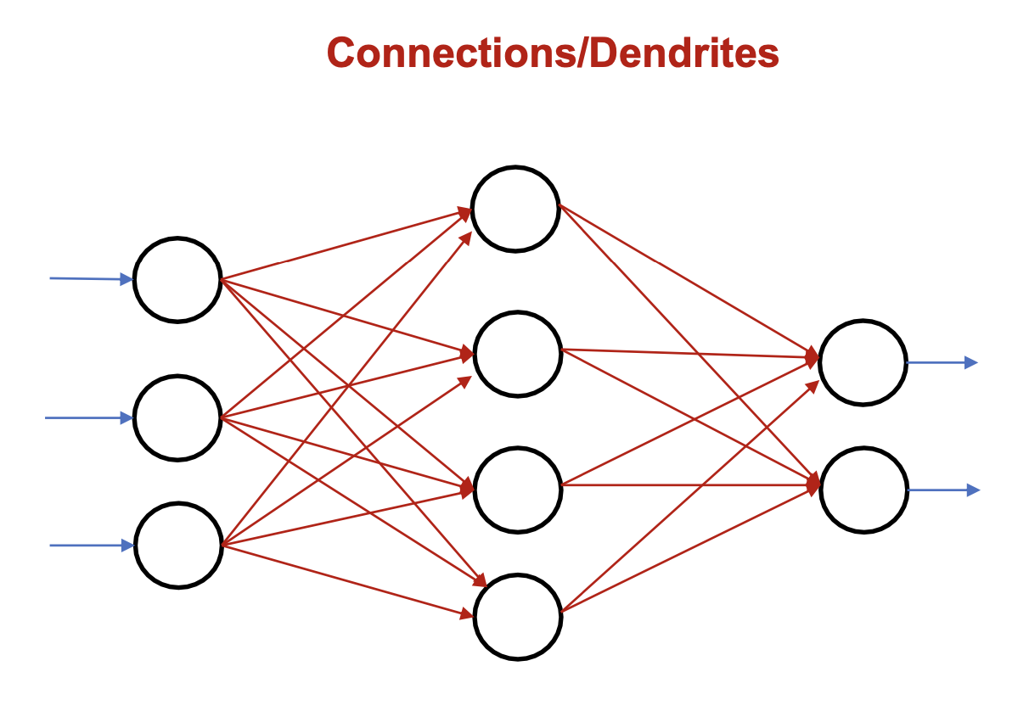
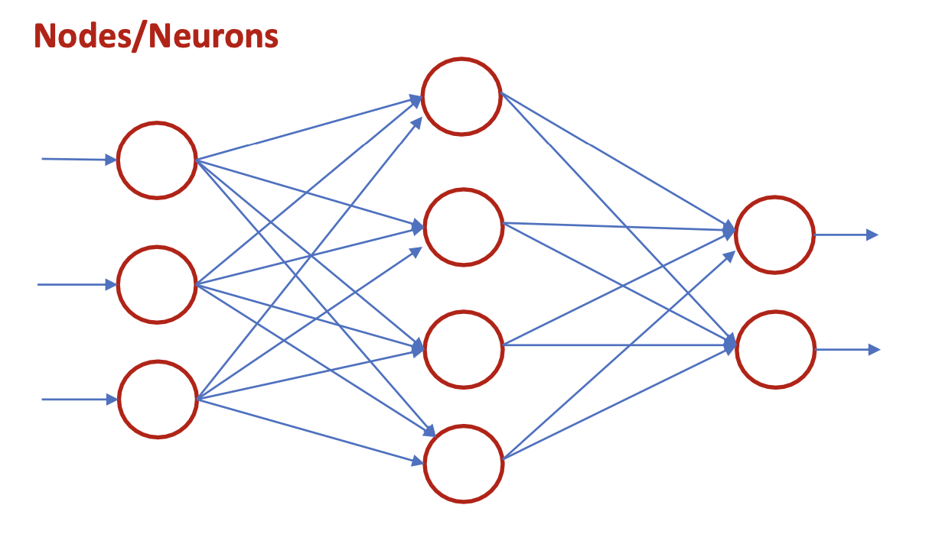
Neural Network Terminologies: Connections
Weights
Bias
Strength of connections between neurons. They determine signal influence.
An additional input to a neuron. It shifts the activation function.

Slide 14
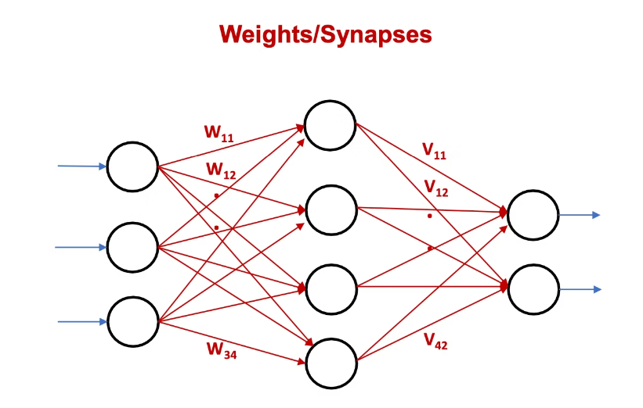
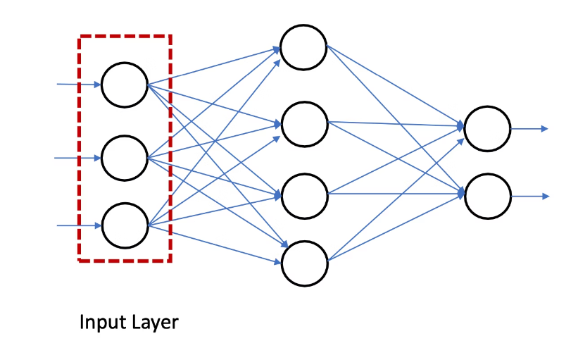
Neural Network Terminologies: Processing
Forward Propagation
Activation Function
Data moves from input to output. Neurons calculate their outputs sequentially.
Determines neuron output. Introduces non-linearity for complex patterns.

Slide 15
Neural Network Terminologies: Learning
Loss Function
1
Measures prediction error. Quantifies model performance.
Backpropagation
2
Adjusts weights and biases. Minimizes the loss function iteratively.

Slide 16
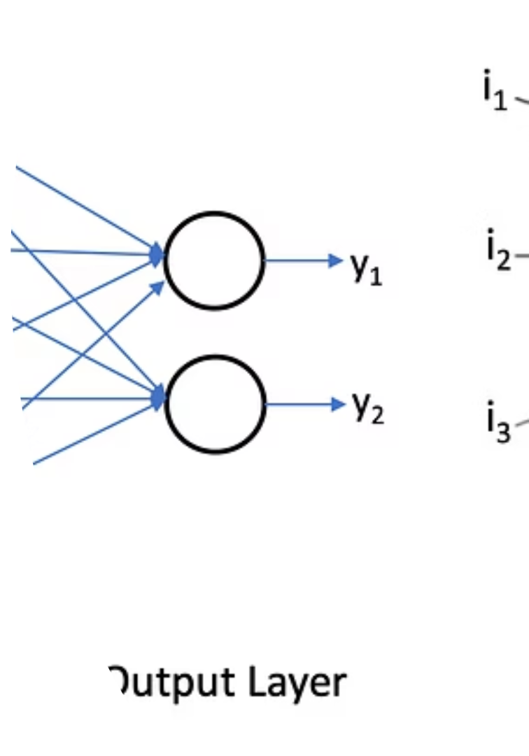



Training and Optimization
Epochs
One full pass through the dataset. Multiple epochs refine learning.
Batch Size
Number of samples processed at once. Influences training speed and stability.
Learning Rate
Controls weight adjustment speed. A crucial hyperparameter.

Slide 17
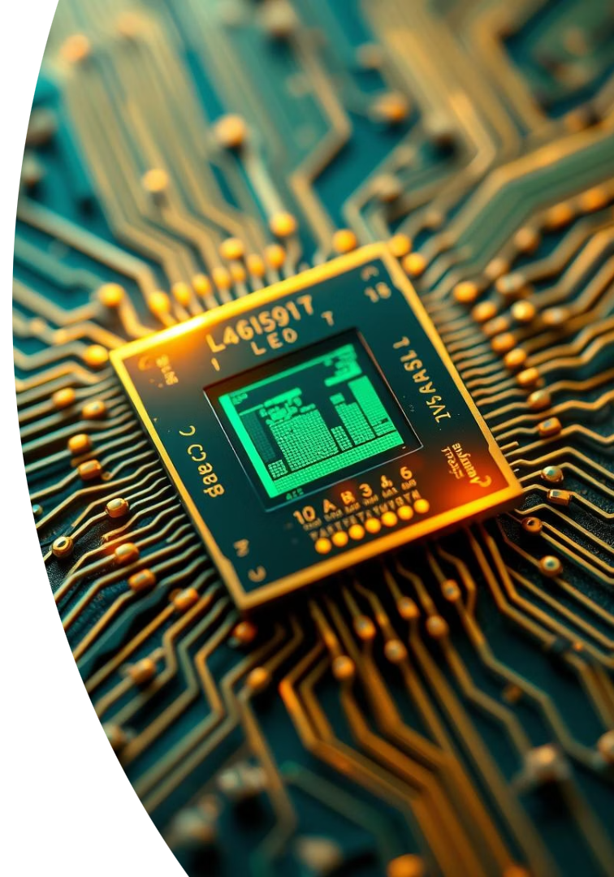
Thank You!
We've covered the core concepts of artificial neurons and neural networks. Understanding these terminologies is crucial for your journey into AI and machine learning. Keep exploring and building!

